Slide 1
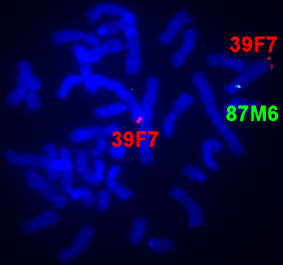

Slide 2
39F7
87M6
87M6
39F7
87M6
39F7

Slide 3
Supplementary Table 1. Primer sequences used for qPCR expression study.
Primer name | Sequence | Source
p18S-F | CGCGGAAGGATTTAAAGTG | Lee et al 2015, StemCells International, DOI:10.1155/2015/235192
p18S-R | AAACGGCTACCACATCCAAG
pBACT-F | GACATCCGCAAGGACCTCTA | Das et al. 2013, Cytogenet Genome Res, DOI: 10.1159/000351310
pBACT-R | ATCTGCTGGAAGGTGGACAG
pGAPDH-F | CATGGCCTCCAAGGAGTAAG | Das et al. 2013, Cytogenet Genome Res, DOI: 10.1159/000351310
pGAPDH-R | TCTGGGATGGAAACTGGAAG
pMLH1-F | AGTTATCCGGCGGTTGGAC | this manuscript
pMLH1-R | CCTCCCTCTTTAACCACCACT
pSOX2-F | GGGGACCTACGGGACATGAT | this manuscript
pSOX2-R | GAGAGAGAGGCAGTGTACCG
pSRY-F | CGGCAGTACTATGCAGCCAA | this manuscript
pSRY-R | GTTGCAGCGATCCTCCTGTT
pUBE2B-F | CCGCCAACTGTTAGGTTTTTATCC | this manuscript
pUBE2B-R | CTGTGCTGCCTGGCTATTGG
pYWHAZ-F | ATGCAACCAACACATCCTATC | Erkens et al 2006, BMC Biotechnol, DOI: 10.1186/1472-6750-6-41
pYWHAZ-R | GCATTATTAGCGTGCTGTCTT
pZFY-F | GGACCAGCAAGATGGTGACA | this manuscript
pZFY-R | ATCCTCTCCAGGGTCAGCTT

