Slide 1
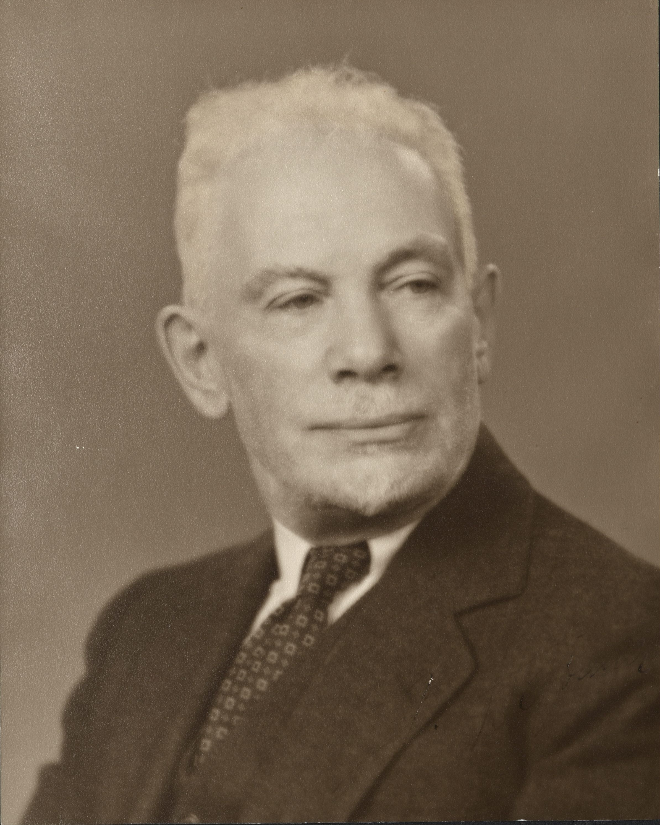
Suppl. Figure 1. J. Isfred Isidor Hofbauer, an American gynaecologist (1879-1961) whom the macrophages of the chorionic villi of the placenta are named after. (photograph courtesy of the Rubenstein Rare Book & Manuscript Library of Duke University.

