Slide 1
Suppl. Fig. 1. Effects of casein hydrolysate (CNH) and casein ingestion prior to epicutaneous sensitization on the T cell population. (a) Percentages of CD25⁺ Foxp3⁺ Treg cells in the mesenteric lymph node (MLN, left) and spleen (right) cells. (b) Percentages of ICOS+ activated T cells in MLN (left) and spleen (right) cells. Data are represented as mean ± SEM (n = 8). There was no significant difference between the CTL group and the other groups.
(a)
20
MLN
20
spleen
15
15
10
10
%CD25⁺Foxp3⁺ of CD4⁺
%CD25⁺Foxp3⁺ of CD4⁺
5
5
0
Sham
CTL
CNH
casein
0
Sham
CTL
CNH
casein
(b)
3
MLN
3
spleen
2
2
%ICOS⁺ of CD4⁺
%ICOS⁺ of CD4⁺
1
1
0
Sham
CTL
CNH
casein
0
Sham
CTL
CNH
casein

Slide 2
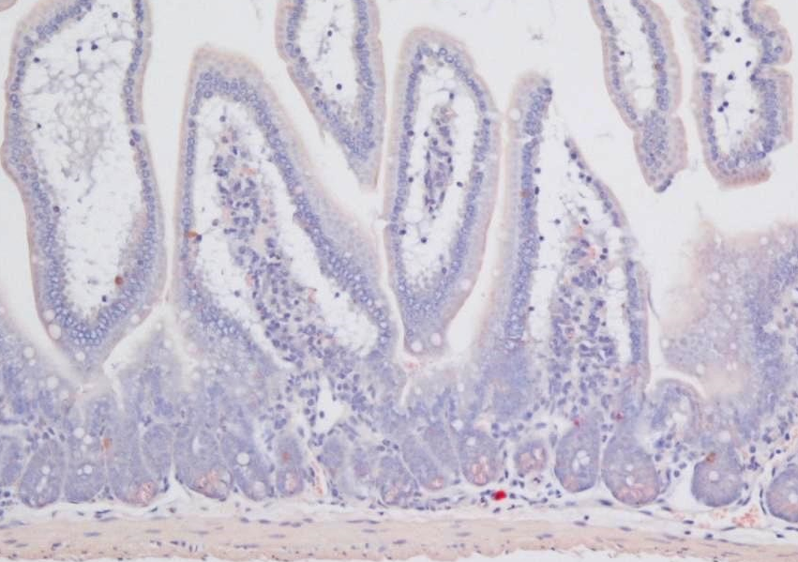
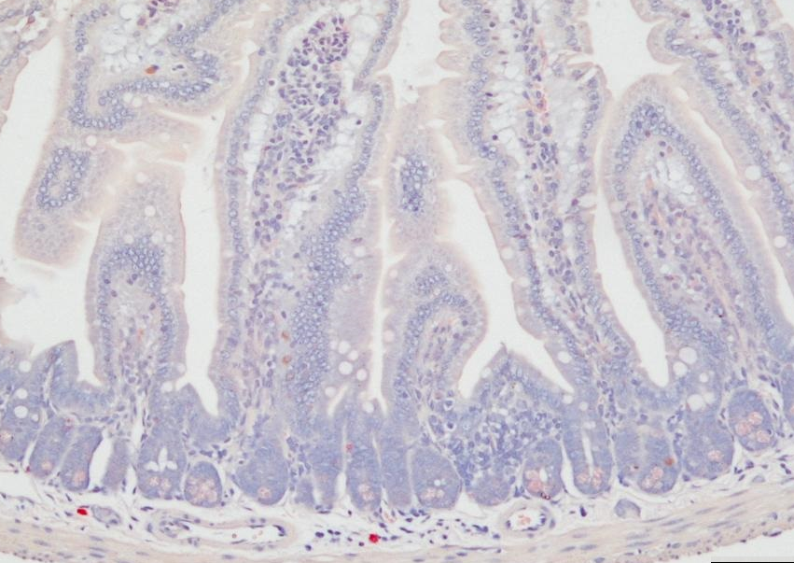
Sham
CTL
100
80
60
CNH
casein
Mast cells in 10 HPFs
40
20
0
Sham
CTL
CNH
casein
Suppl. Fig. 2. Mast cells in the small intestine of epicutaneously sensitized mice. Esterase- stained mast cells in the mucosal (black bars) and submucosal (white bars) layer were counted in 10 high-power fields (HPF) at 400× magnification. Grey bars show total numbers. Scale bar = 100mm. Data are represented as mean ± SEM (n = 8). There was no significant difference between the CTL group and the other groups.

