Slide 1
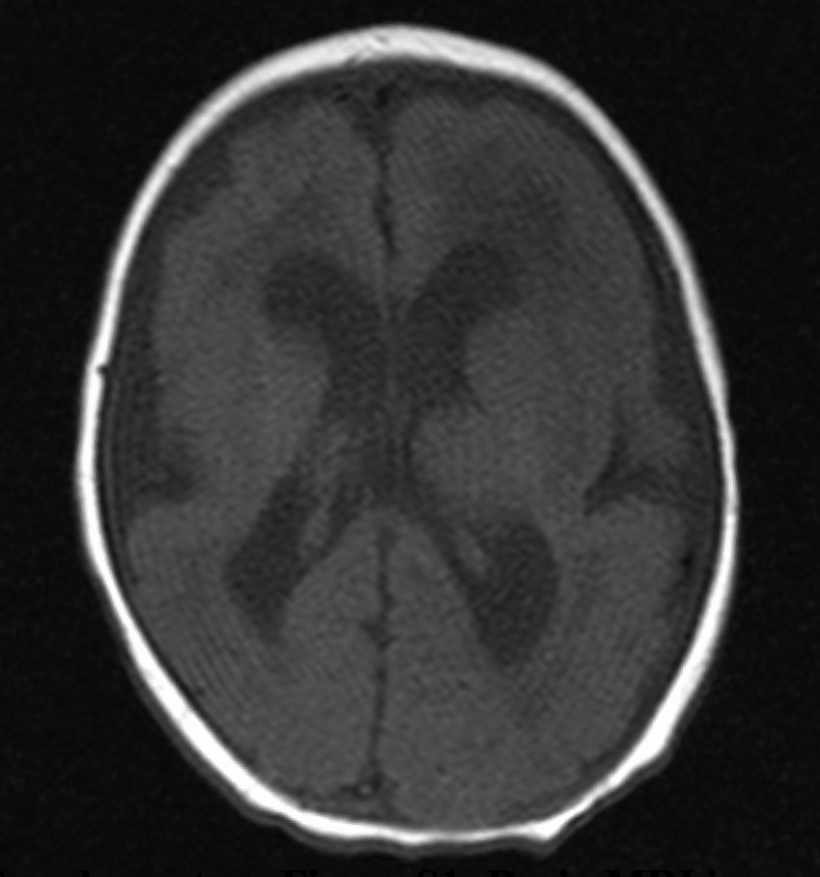
Supplementary Figure 1
A
A
B
B
T1WI
T2WI
FH
OH
Supplementary Figure S1: Brain magnetic resonance images of ventriculomegaly. A. Axial T1-weighted image with ventriculomegaly (FH: frontal horn, OH: occipital horn). B. Axial T2-weighted image with ventriculomegaly. Ventriculomegaly was defined as frontal and occipital horn ratio greater than 0.4.

Slide 2
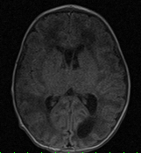
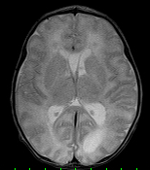
Supplementary Figure 2
A
B
T1WI
T2WI
Supplementary Figure S2: Brain magnetic resonance images of periventricular cysts. A. Axial T1-weighted image with periventricular cysts (white arrowheads). B. Axial T2-weighted image with periventricular cysts (white arrowheads). Periventricular cysts were defined as parenchymal round lesions close to the ventricle lining with a cerebrospinal fluid-like signal.

Slide 3
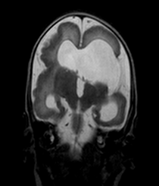
Supplementary Figure 3
T2WI
T2WI
Supplementary Figure S3: Brain magnetic resonance images of hippocampal dysplasia. Coronal T2-weighted image with hippocampal dysplasia (white arrowheads). Hippocampal dysplasia was defined as incomplete rotation of the hippocampal formation.

Slide 4
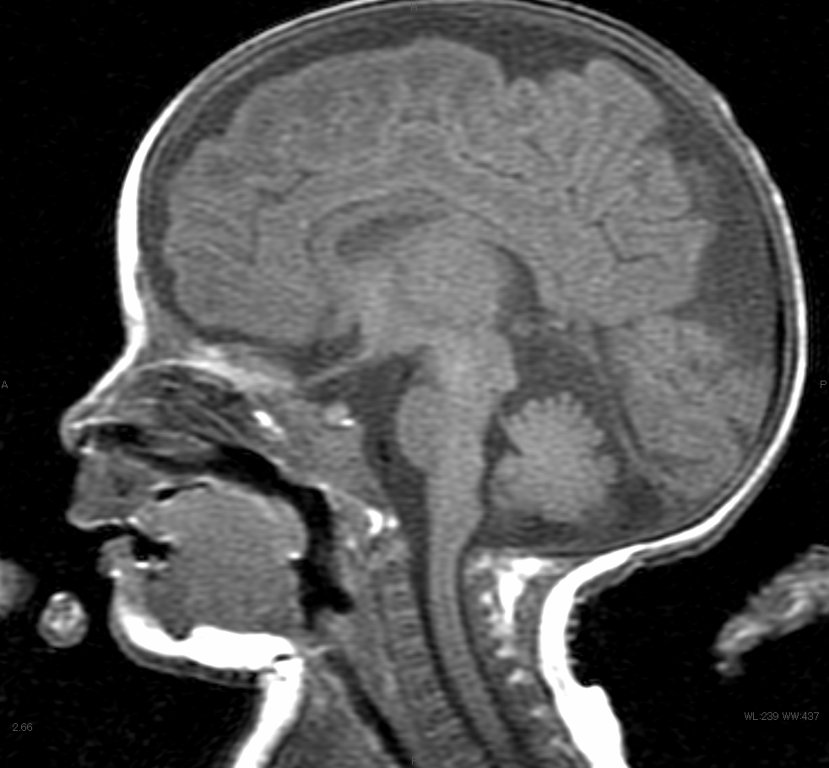
Supplementary Figure 4
A
B
T1WI
T1WI
Supplementary Figure S4: Brain magnetic resonance images of cerebellar hypoplasia. A. Axial T1-weighted image with cerebellar hypoplasia (white arrowheads). B. Sagittal T1-weighted image with cerebellar hypoplasia (white arrowheads). Cerebellar hypoplasia was defined as marked reduction in size with reduced number of folia.

Slide 5
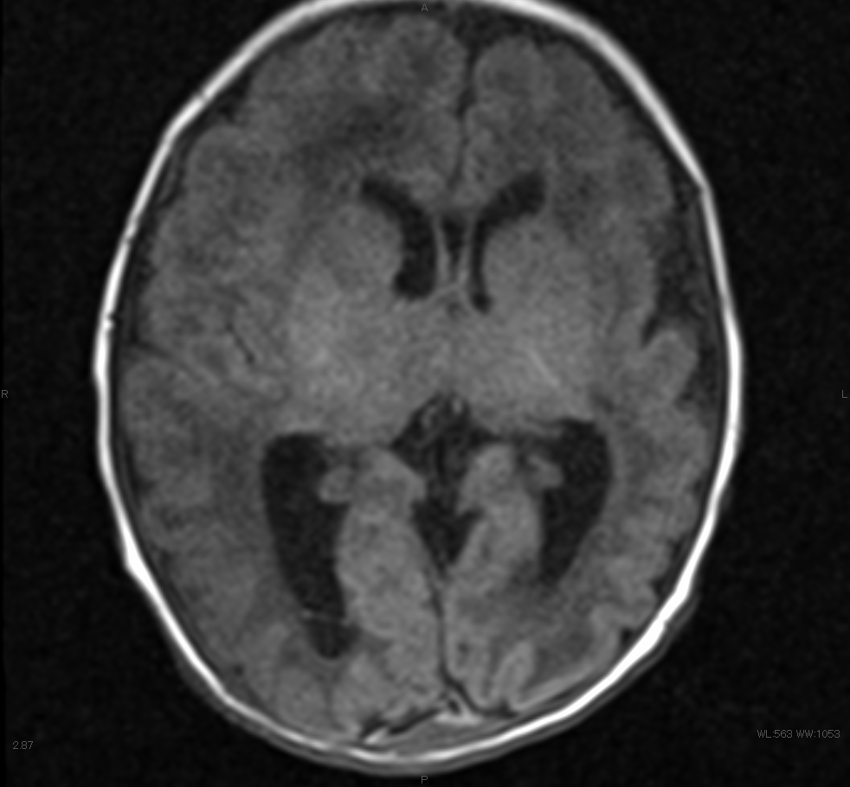
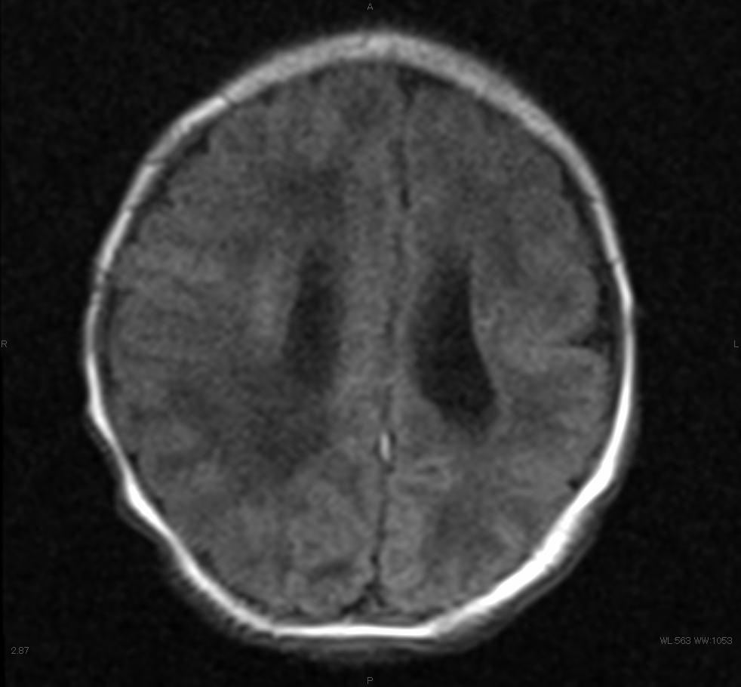
Supplementary Figure 5
A
B
T1WI
T1WI
Supplementary Figure S5: Brain magnetic resonance images of migration disorders. A. Axial T1-weighted image with polymicrogyria (white arrowheads). B. Axial T1-weighted image with pachygyria (white arrowheads). Migration disorders were defined as presence of polymicrogyria, pachygyria, or lissencephaly.

Slide 6
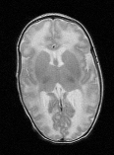
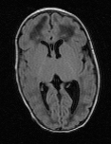
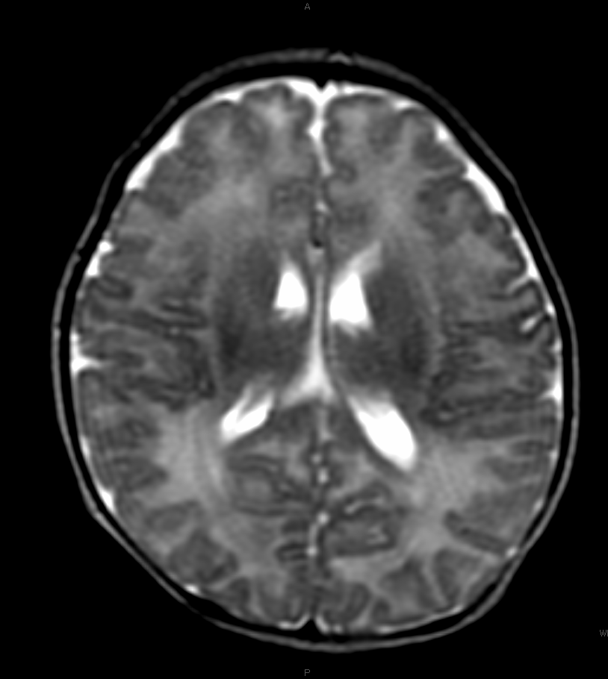
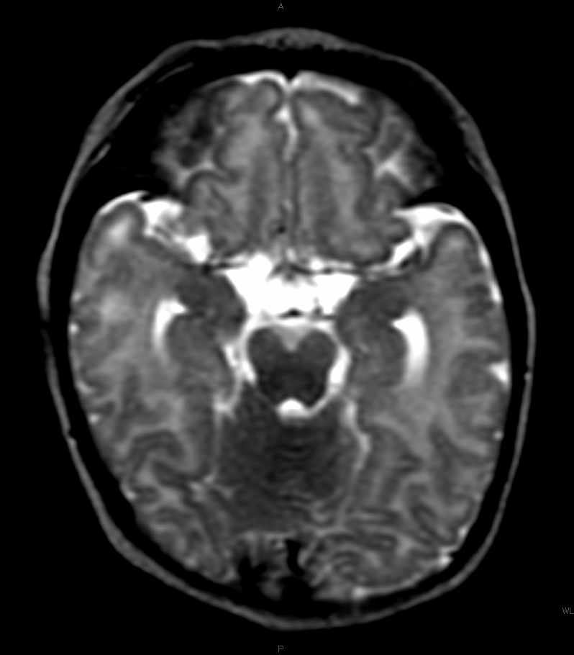
Supplementary Figure 6
A
B
T2WI
T1 FLAIR
C
D
T2WI
T2WI
Supplementary Figure S6: Brain magnetic resonance images of white matter abnormalities. A. Axial T2-weighted image with white matter abnormalities (white arrowheads). B. Axial T1-fluid-attenuated inversion recovery image with white matter abnormalities (white arrowheads). C. Axial T2-weighted image with subtle white matter abnormalities (white arrowheads). D. Axial T2-weighted image with subtle white matter abnormalities (white arrowheads).

Slide 7
Supplementary Table 1
 | MRI abnormality (+) n=28 | MRI abnormality (-) n=14 | P value
Gestational age at birth (weeks) | 36 (31-40) | 39 (32-40) | 0.05
Birth weight (g) | 2221 (940-3312) | 2877 (2326-3538) | <0.01
Birth weight (SD) | -1.2 (-3.8 to 2.6) | -0.3 (-1.3 to 1.5) | 0.02
Birth height (cm) | 45.3 (35-51) | 49.8 (43-51.8) | <0.001
Birth height (SD) | -1.3 (-3.3 to 2.2) | 0.3 (-1.3 to 1.7) | <0.005
Head circumference at birth (cm) | 31.5 (25.5-34.8) | 33 (30.5-35.3) | <0.01
Head circumference at birth (SD) | -0.5 (-3.7 to 1.5) | 0.0 (-1.8 to 1.5) | 0.09
Small for gestational age | 11 (39) | 0 (0) | <0.01
Male (%) | 11 (39) | 9 (64) | 0.19
Apgar Score at 1 min | 8 (3-9) | 9 (6-9) | 0.14
Apgar Score at 5 min | 9 (3-10) | 9 (8-10) | 0.02
Neonatal asphyxia | 4 (14) | 1 (7) | 0.65
Umbilical cord arterial pH* | 7.32 (7.16-7.41) n=16 | 7.30 (7.23-7.37) n=7 | 0.76
Any symptoms | 21 (75) | 2 (14) | <0.01
Hepatosplenomegaly / Liver dysfunction | 8 (29) | 0 (0) | 0.04
Thrombocytopenia | 11 (39) | 1 (7) | 0.04
Eye complications | 5 (18) | 0 (0) | 0.16
Hearing dysfunction | 17 (61) | 2 (14) | <0.01
Antiviral therapy | 24 (86) | 0 (0) | <0.0001
Age when MRI performed (day) | 26.5 (3-72) | 24 (3-76) | 0.54
Post-menstrual age when MRI performed (weeks) | 40.5 (35-50) | 42 (37-49) | 0.56
Supplementary Table 1: Brain MRI findings and clinical confounding factors. Birthweight, birth height, head circumference at birth, small for gestational age, and any clinical symptoms were significantly associated with brain MRI abnormality (all ps <0.01); however, the timing of MRI imaging (including postnatal ages [days] and post-menstrual ages [weeks]), was not associated.
*In the clinical symptoms and without symptoms groups, the umbilical cord arterial pH was measured 16 and 7 times, respectively. SD, standard deviation; MRI, magnetic resonance imaging.
Neonatal asphyxia was defined as ≤ 6 for the Apgar score at 1 min. Liver dysfunction was defined as serum alanine aminotransferase level > 100 IU/L. Thrombocytopenia was defined as platelet count < 1 x 10⁵/µL. Eye complications were defined as retinitis and choroiditis, among others. Hearing dysfunction was defined as abnormal auditory brainstem response; V-wave threshold ≥ 30 dB for infant born after 37 weeks of gestation, ≥ 40 dB for infant born between 34 and 36 weeks of gestation.

Slide 8
Supplementary Table 2
 | MRI findings (+) | MRI findings (-) | P value
Ventriculomegaly | 5.5×10⁷ (1.0×10⁵-2.9×10⁸) n=20 | 5.85×10⁶ (9.0×10³-3.1×10⁹) n=22 | 0.04
Periventricular cysts | 4.9×10⁷ (1.0×10⁵-1.7×10⁹) n=13 | 1.0×10⁷ (9.0×10³-3.1×10⁹) n=29 | 0.21
Hippocampal dysplasia | 4.0×10⁵ n=1 | 2.5 ×10⁷ (9.0×10³-3.1×10⁹) n=41 | -
Cerebellar hypoplasia | 8.2×10⁶ (4.0×10⁵-6.2×10⁷) n=3 | 2.5×10⁷ (9.0×10³-3.1×10⁹) n=39 | 0.57
Migration disorders | 4.9×10⁷ (1.0×10⁵-2.9×10⁷) n=7 | 2.0×10⁷ (9.0×10³-3.1×10⁹) n=35 | 0.95
White matter abnormalities | 2.65×10⁷ (9.0×10³-1.7×10⁹) n=26 | 1.7×10⁷ (9.2×10³-3.1×10⁹) n=16 | 0.91
Any MRI abnormality | 2.7×10⁷ (9.0×10³-1.7×10⁹) n=28 | 1.2×10⁷ (9.2×10³-3.1×10⁹) n=14 | 0.66
Supplementary Table 2: Brain MRI findings and urine viral load. The titer of urine viral load did not correlate with the 6 examined MRI abnormalities or the incidence of any brain MRI abnormality. MRI: magnetic resonance imaging.

Slide 9
Supplementary Table 3
Case |  | 1 | 2 | 3 | 4 | 5 | 6 | 7 | 8 | 9 | 10 | 11 | 12 | 13 | 14 | 15 | 16
HUS | Periventricular cysts | - | - | + | - | + | - | - | - | - | + | - | + | + | + | - | -
 | Ventriculomegaly | + | + | + | + | - | + | - | + | - | + | + | + | + | - | - | -
 | Intracranial calcification | + | - | + | - | + | - | - | + | - | + | - | - | - | + | - | -
MRI | Periventricular cysts | + | - | + | + | + | - | - | + | - | + | - | - | + | + | - | -
 | Ventriculomegaly | + | + | + | + | + | + | - | + | - | + | - | + | + | - | - | -
 | Intracranial calcification | + | + | + | + | - | - | + | + | - | - | - | - | - | - | - | -
concordance | Periventricular cysts |  | ✓ | ✓ |  | ✓ | ✓ | ✓ |  | ✓ | ✓ | ✓ |  | ✓ | ✓ | ✓ | ✓
 | Ventriculomegaly | ✓ | ✓ | ✓ | ✓ |  | ✓ | ✓ | ✓ | ✓ | ✓ |  | ✓ | ✓ | ✓ | ✓ | ✓
 | Intracranial calcification | ✓ |  | ✓ |  |  | ✓ |  | ✓ | ✓ |  | ✓ | ✓ | ✓ |  | ✓ | ✓
Supplementary Table 3: Comparison of head ultrasound at birth and brain MRI imaging in preterm infants with congenital cytomegalovirus infection. The head ultrasound at birth and brain MRI findings were compared in sixteen preterm infants. The detection rate of each brain lesion via head ultrasound and brain MRI was 6/16 and 8/16 for periventricular cysts, 10/16 and 10/16 for ventriculomegaly, and 6/16 and 6/16 for intracranial calcification. The diagnostic concordance was 12/16 (75%) in periventricular cysts, 14/16 (87.5%) in ventriculomegaly, and 10/16 (62.5%) in intracranial calcification. HUS: head ultrasound, ✓: Cases of the HUS and MRI results were matched, MRI: magnetic resonance imaging.

