Slide 1
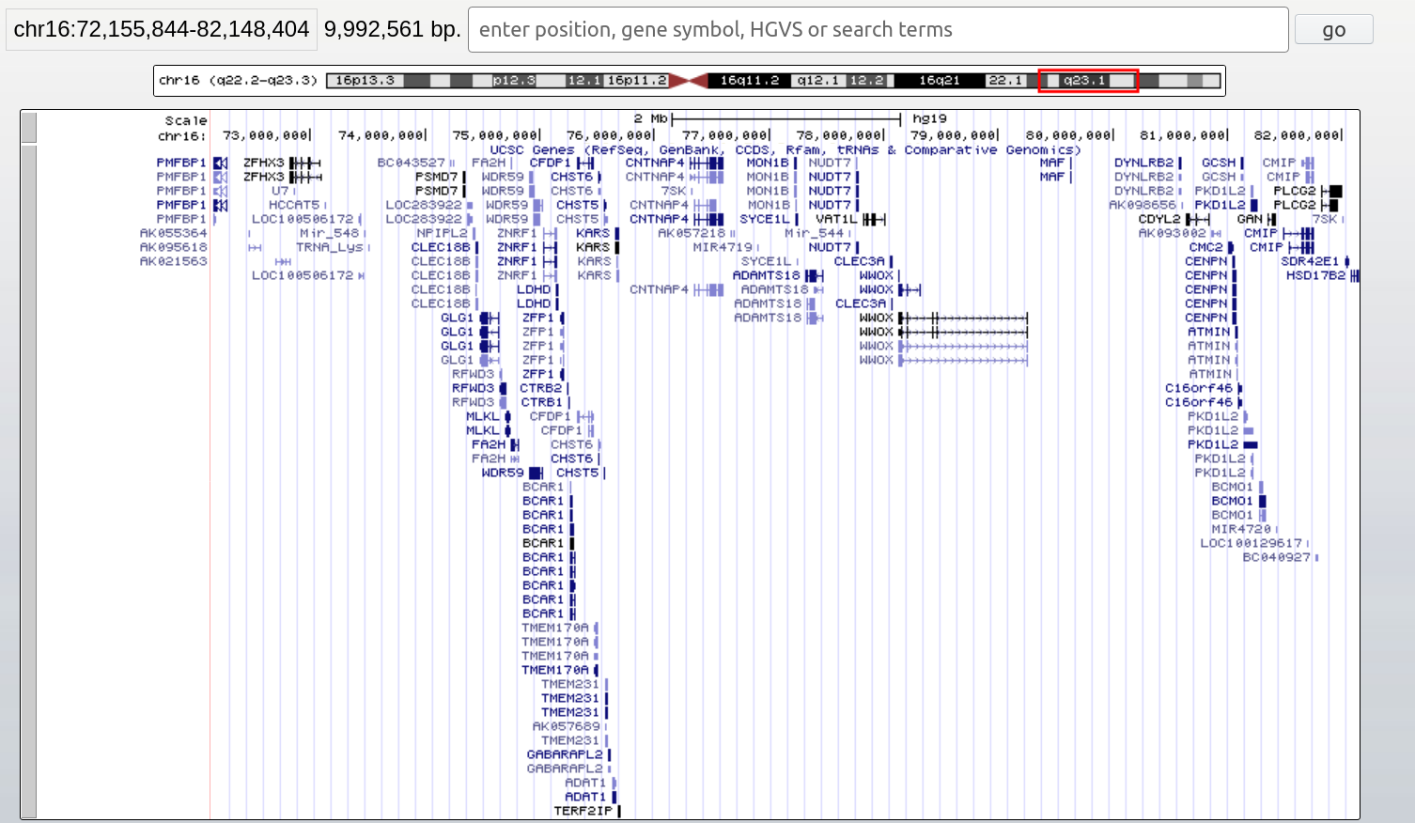
Supplementary Figure 1. The resented patient’s 16q deletion and the encompassed genes. Source: https://genome-euro.ucsc.edu/index.html

