Slide 1
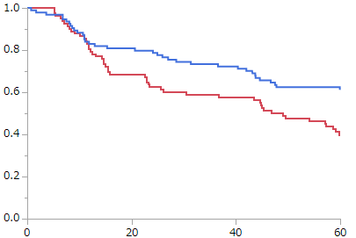
Supplementary Figure 2
Kaplan–Meier analysis of five-year overall survival in relation to PROX1 depending on the (a) presence or (b) absence of lymphatic invasion.
(a) Presence of lymphatic invasion
Low expression (n=94)
Overall survival
High expression (n=83)
P = 0.023
Months after operation

Slide 2
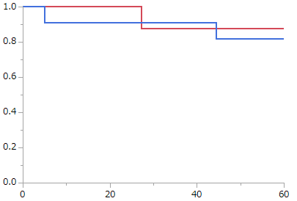
Supplementary Figure 2
(b) Absence of lymphatic invasion
High expression (n=8)
Low expression (n=11)
Overall survival
P = 0.75
Months after operation

