Slide 1
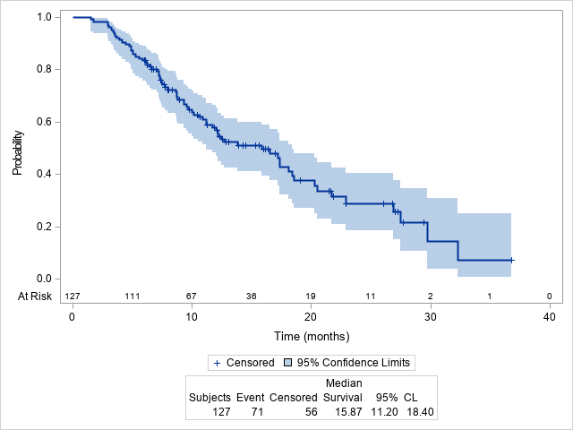
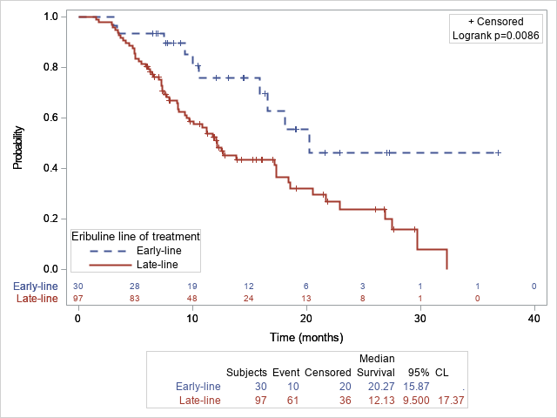
a. Patients at any lines of eribuline
b. Patients stratified by lines of eribuline
Supplementary Fig. S6. Overall survival with lost to follow-up ones as death (OS1) among all enrolled patients (total n=127)

