Slide 1
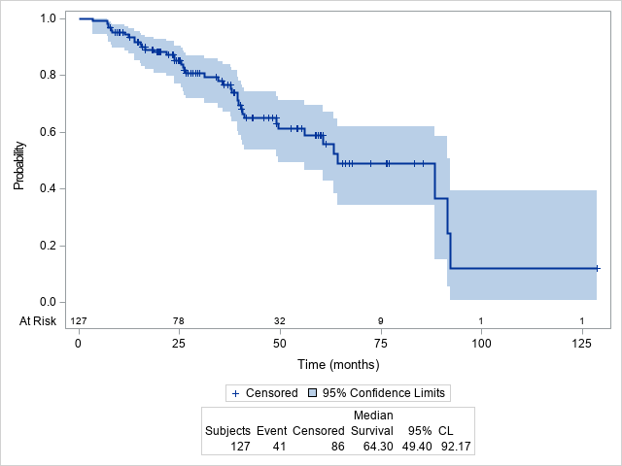
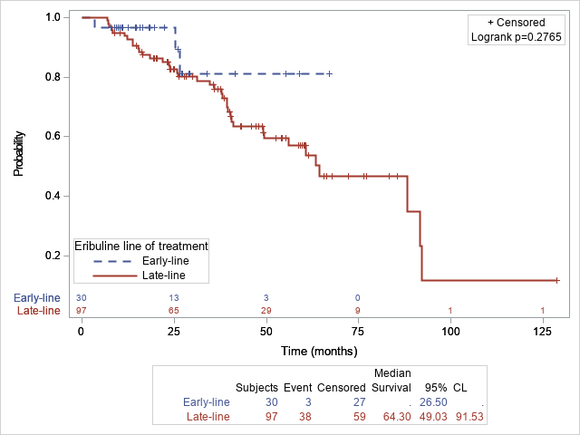
a. Patients at any lines of eribuline
b. Patients stratified by lines of eribuline
Supplementary Fig. S8. Overall survival from metastasis diagnosis date to death (OS3) among enrolled patients (N=127)

